Slide 1
Chat Secure
Vijay Fathur R. ( 5112100043 )
Faishal Azka J. (5112100061 )
R.M. Iskandar Z. (5112100101 )
I Gede Arya Putra Perdana ( 5112100151 )

Slide 2
Protocol
——Saat pilih menu signup——
Client : "SIGNUP" “SIGNUP_REQ” "0" "0" “NULL” “NULL”
*accepted
SERVER : "SIGNUP" "AUTH_REQUIRED" "0" "0" "NULL" "NULL"
*error
SERVER : “HOME” “ERROR” "0" "0" "NULL" "NULL");
Client : "SIGNUP" “AUTH_REQUEST” "0" "0" “AUTH” “<Username:Password>“

Slide 3
Protocol
*accepted
SERVER : “INCHAT” “SIGNUP_SUCCESS” "0" “<Username pengirim>“ “NULL” “NULL“
Client : “INCHAT” “LIST_USER_REQ” “0” “<Username pengirim>” “NULL” “NULL”
SERVER : “INCHAT” “LIST_USER_SEND” "0" “<Username pengirim>“ “LIST” “<UsernameAllOnline>“
Client : “INCHAT” “LIST_USER_REQ” “0” “<Username pengirim>” “NULL” “NULL” //looping
> jika selesai
SERVER : “INCHAT” “LIST_USER_DONE” "0" “<Username pengirim>“ “NULL” “NULL“
Client : “INCHAT” “LIST_USER_OK” “0” “<Username pengirim>” “NULL” “NULL”
*error
SERVER : "SIGNUP" “SIGNUP_FAILED” "0" “0” “NULL” “NULL“
Client : “SIGNUP” “SIGNUP_RETRY” "0" "0" “NULL” “NULL” back loop
—-END MENU SIGNUP—-

Slide 4
Protocol
——Saat pilih menu login——
Client : “LOGIN” “LOGIN_REQ” "0" "0" “NULL” “NULL”
#######
*terima
SERVER : “LOGIN” "AUTH_REQUIRED" "0" "0" "NULL" "NULL"
*error
SERVER : “HOME” “ERROR” "0" "0" "NULL" "NULL");
#######
Client : “LOGIN” “AUTH_REQUEST” "0" "0" “AUTH” “<Username:Password>“

Slide 5
Protocol
*terima
SERVER : “INCHAT” “LOGIN_SUCCESS” "0" “<Username pengirim>“ “NULL” “NULL“
SERVER : “INCHAT” “LIST_USER_SEND” "0" “<Username pengirim>“ “LIST” “<UsernameAllOnline>“
Client : “INCHAT” “LIST_USER_REQ” “0” “<Username pengirim>” “NULL” “NULL” looping
> jika selesai
SERVER : “INCHAT” “LIST_USER_DONE” "0" “<Username pengirim>“ “NULL” “NULL“
Client : “INCHAT” “LIST_USER_OK” “0” “<Username pengirim>” “NULL” “NULL”
*error
SERVER : “LOGIN” “LOGIN_FAILED” "0" “0” “NULL” “NULL“
Client : “LOGIN” “LOGIN_RETRY” "0" "0" “NULL” “NULL” back loop
—-END MENU LOGIN—

Slide 6
Protocol
—-Saat di chat—-
Client : “INCHAT” “SEND_MESSAGE” “<receiver’s username>“ “<sender’s username>“ “STRING” “<Pesan>”
SERVER : ^ meneruskan

Slide 7
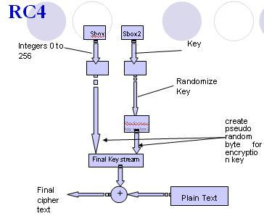
RC4 Algorithm
Aplikasi chat ini menggunakan enkripsi RC4 karena algoritma tersebut adalah algoritma yang simpel dan cepat untuk stream cipher

Slide 8
Alur Algoritma RC4
Proses Inisialisasi S-Box(Array S)
for i = 0 to 255
S[i] = i
Proses Inisialisasi S-Box (Array K)
array Kunci // Array dengan panjang kunci “length”.
for i = 0 to 255
K[i] = Kunci [i mod length]
Proses Pengacakan S-Box
i = 0; j = 0;
for i = 0 to 255 {
j = (j + S[i] + K[i]) mod 255
Swap S[i] dan S[j]
}
Pseudo Random Byte
i = (i + 1) mod 255
j = (j + S[i] mod 255
swap S[i] dan S[j]
t = (S[i] + S[j] mod 255
K = S[t]
Kemudian byte K di-XOR kan dengan plaintext untuk menghasilkan ciphertext

Slide 9
Things to be Encrypted
Semua isi dalam format protokol akan di enkripsi menggunakan RC4 optional : data password yang disimpan

Slide 10
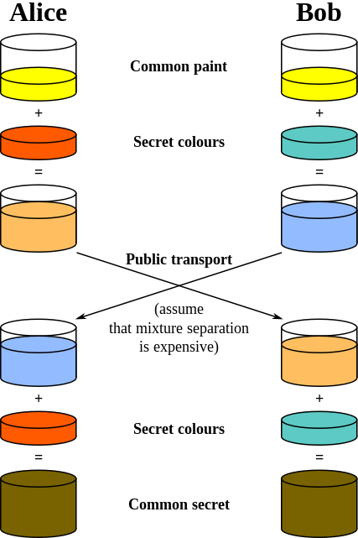
Distributing the Key
Menggunakan algoritma Diffie-Helman untuk meng-generate key dalam enkripsi pesannya
Tiap user dalam aplikasi memiliki 1 private key, kemudian pada masing-masing user akan mengkalkulasikan private key-nya untuk memperoleh public key
Public key dari tiap user didapat dari :
gª mod p
p = large prime number
g = generator atau base ( 0 < g < p )
a = private key
Public key ini akan di-share satu sama lain

